Slide 1

Spotify Song Genre Prediction
Ivan Escalona, Daisy Khamphakdy, Iris Lew, Shuo Wang, Amanda Teschko
W207, MIDS

Slide 2
Dataset
Kaggle link: https://www.kaggle.com/datasets/mrmorj/dataset-of-songs-in-spotify
Dimension: 42,305 rows x 22 columns
Features:
‘danceability', 'energy', 'key', 'loudness', 'mode', 'speechiness', 'acousticness', 'instrumentalness', 'liveness', 'valence', 'tempo', 'type', 'id', 'uri', 'track_href', 'analysis_url', 'duration_ms', 'time_signature', 'genre', 'song_name', 'Unnamed: 0', 'title'
Data dictionary:
https://developer.spotify.com/documentation/web-api/reference/#/operations/get-audio-features
https://docs.google.com/document/d/1LWl88F8wGY1WkkOSzzVzwSYij1yeMR8hFXllRpkMyrI/edit
Notes:
AMANDA
Introduce the dataset
The dataset we used was taken from Kaggle and includes 22 audio attributes for 42k Spotify songs.

Slide 3
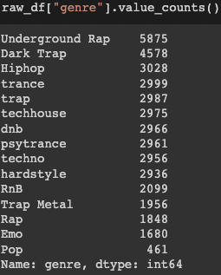
What is the best ML model for song genre prediction?
Goal: Spotify executives have asked the data science team to have its music app automatically recognize a song’s genre when a song is added to its database, rather than manually classifying a song genre. This will help improve song library customization by learning what song genres are listened to most.
How?: The data science team will build machine learning models that will learn to distinguish songs based on key audio features. The team will then determine the best model for predicting and recognizing song genres.
Notes:
AMANDA
Introduce:
When songs are added to the Spotify database, no genre is associated with the song.
Our project was intended to use the audio feature to try to categorize each track into its appropriate genre. There were 15 genres represented in the dataset, as you can see in the rightmost chart.

Slide 4
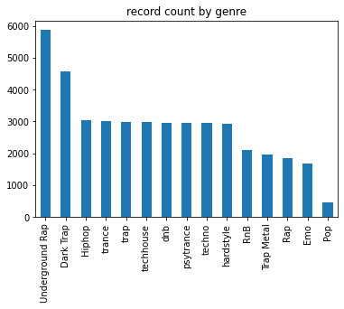
EDA - Quick Summary
Underground rap was the most popular genre
Imbalance in the records per genre
Some numeric features are on different scales
Some fields has high levels of missing data
Some rows are duplicated
Some tracks are mapped to more than one genre
Notes:
AMANDA
While the dataset was fairly clean, you’ll recall from our prior presentation that as part of our EDA, we identified unnecessary columns or those that were mostly null and dropped them from the dataset

Slide 5
Feedback from Post Baseline Presentation
Consider how to handle tracks mapped to multiple genres
Include a baseline to compare model performance to
Consider balancing the dataset to have more equal representation of genre
Consider scaling numeric features
Notes:
AMANDA (IRIS)
There were four main areas of feedback we received from our baseline presentation, which we’ve incorporated into our latest approach. The primary concerns we looked to tackle were:
Correcting the tracks that were mapped to multiple genres; To simplify our problem, we decided to randomly sample one genre from any track with multiple genres associated with it. This allowed our track id to be the unique identifier for the analysis.
Included a baseline to compare our results to
Looking into balancing options
And considering scaling the numeric features

Slide 6
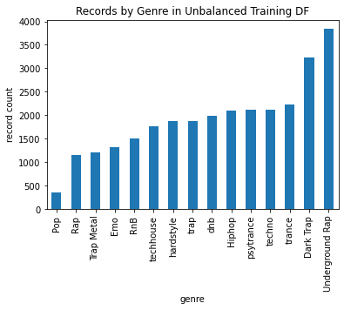
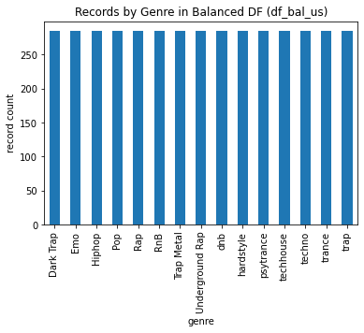
Addressing Imbalanced Data
We discovered we have imbalance data and will run our models with:
The unbalanced data
Undersampled balanced data
Set sample size at 80% of smallest genre
Random sample equally from all genres
Notes:
AMANDA (IRIS)
As we began working with our model we recognized that there was an imbalance in the data, with genres like underground rap occurring almost 10 times as frequently as pop in our sample dataset.
We explored models that used the unbalanced dataset and compared them to models that used a balanced dataset.
We looked into both undersampling and oversampling techniques, but ultimately decided to just look at undersampling.
We undersampled the data by taking 80% of the smallest genre, Pop, and randomly drawing that amount from each dataset.
We balanced our training dataset and ran that dataset on our full test data to see if balancing the sample could give us better prediction in our full test dataset.

Slide 7
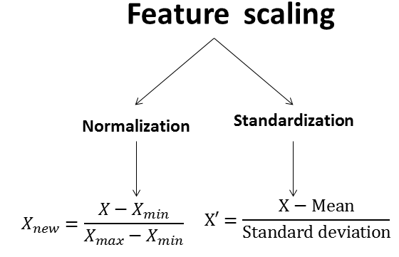
Scaling Numeric Features
To account for different scales in our numeric features, we will train different permutations of models using:
Unscaled data
Normalized data
Rescale between zero and one using min and max
MinMaxScaler()
Standardized data
Remove mean and scale to unit variance
StandardScaler()
Notes:
AMANDA (IRIS)
We ran a series of model that compared using the unscaled features, standardized features, and normalized features to see which models would perform best on which types of scaling.

Slide 8
Baseline Model
ALWAYS predict the most most popular genre from the raw data (Underground Rap)
Data Set | Accuracy
Imbalanced - Training | 13.39%
Undersampling - Training | 6.67%
Test | 13.34%
Notes:
AMANDA (IRIS)
For our baseline model, we assumed that we would always predict the most popular genre, which was Underground rap. Predicting underground rap every time would give us a little over 13% accuracy in our training and test dataset, both of which are from the unbalanced data..
We decided to only split the data and then balance our training set only. This is because our intuition is that song genres do not appear in Spotify’s database in equal proportions and we could not find any evidence when we looked at the documentation for the data source. In our undersampled dataset, the genres are balanced, so picking Underground Rap (or any genre for that matter), would give us an accuracy of 6.67% (or 1/15, as there are 15 genres).

Slide 9
Models
Notes:
Amanda/Iris
We decided to focus on accuracy for our metric.

Slide 10
Results
Test Accuracy
Rank | Models | Unscaled |  | Normalized (MinMaxScaler) |  | Standardized (StandardScaler)
 |  | Unbalanced | Balanced | Unbalanced | Balanced | Unbalanced | Balanced
1 | Random Forest | 0.70 | 0.64 | 0.71 | 0.62 | 0.70 | 0.61
2 | XGBoost | 0.70 | 0.63 | 0.70 | 0.57 | 0.70 | 0.60
3 | Neural Network | 0.133 | 0.055 | 0.615 | 0.424 | 0.684 | 0.54
5 | Logistic Regression | 0.08 | 0.08 | 0.57 | 0.40 | 0.59 | 0.48
4 | KNN (K=5) | 0.26 | 0.45 | 0.55 | 0.47 | 0.57 | 0.49
Notes:
DAISY
To compare which model had the best accuracy results for song genre prediction, we put our test accuracy scores into a table for each model and each data treatment. Each data treatment includes: Unscaled, Normalized or Standardized features and Unbalanced or Balanced data.
Random Forest performed the best with about 70% accuracy on unbalanced data and 60ish percent for balanced data. We didn’t find a drastic change when datasets were normalized or standardized, still at 70% unbalanced and 60ish percent for balanced data.
Gradient Boosting was a close second with similar results, 70% for unbalanced data and 60ish percent for balanced data.
Neural Network and Logistic Regression saw an improvement when the features were normalized and standardized as well as when data was balanced (compared to unscaled and unbalanced).
Logistic regression and KNN sort of a tie in its results when looking at normalized and standardized.
Now, we’ll go into explaining our process and results for each model.

Slide 11
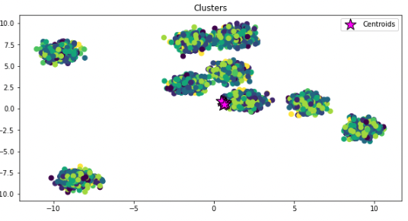
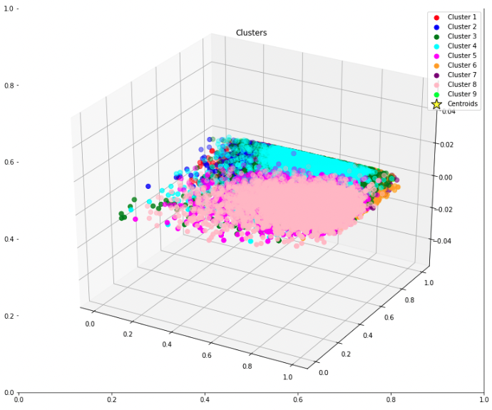
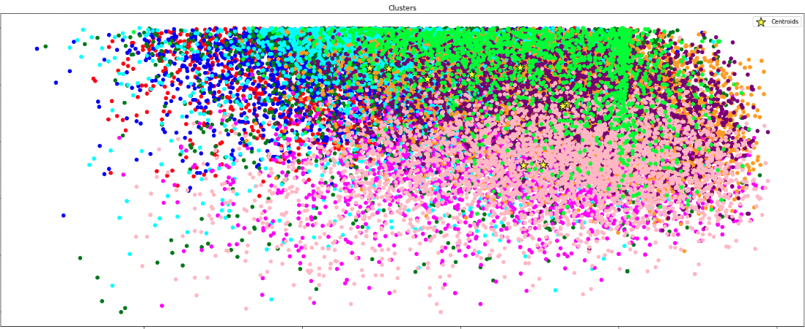
Kmeans
Unsupervised learning on labeled dataset.
Kmeans clustering difficult to visualize.
High dimensional data can make kmeans less effective.
Notes:
DAISY
Evolution
We mentioned in the baseline presentation, KMeans is unsupervised learning so not the best to use for our labeled dataset (or already classified by genre). We already began exploring it, so decided to move forward with trying Kmeans for song clustering to see what we would find.
Results
The clusters were difficult to visualize. As you can see, there’s overlap in clusters and colors and centroids are all based in one location.
These images are for normalized and balanced data and we found similar clustering overlap when it came to other data treatments.
So what?
Because clustering is unsupervised learning, it may be more sensitive to other supervised learning approaches.
And we’re working with high dimensional data (or more features to observations (in this case, more features to song genres)). When the number of features in a dataset exceeds the number of observations, k-means becomes less effective at distinguishing between examples. Might be what’s happening here.
Kmeans may not be best for our dataset.
------------------------------------------------------------------------------
https://developers.google.com/machine-learning/clustering/algorithm/advantages-disadvantages
I know Kmeans is sensitive to data scaling. A single bad attribute can potentially spoil the results.
Kmeans is unsupervised leaer
KMeans - not appropriate for dataset, but thought we go ahead and see what we found
Key takeaways:
Kmeans difficult to visualize. You can see overlapping colors and they are not properly cluster
Clustering did not help supervised learning
Most selected were techno and party trance, despite balancing dataset. Expected to see Underground rap the most selected genre, so expected to see Underground rap.
Did not give us useful insights (sort of expected)
So what?
Would not use in the future. Obviously, would use models geared towards supervised learning.
Kmeans clustering, aimed to group instances into clusters by their similarity.
Not appropriate for supervised clustering (we already have genres)
Did the elbow curve and it recommended 3-4 clusters

Slide 12
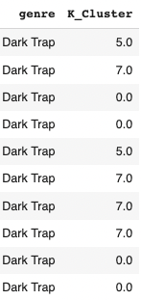
Kmeans
Most popular predicted genres were techno and psytrance.
No useful insights from Kmeans
Highest Predicted Cluster by Each Data Treatment:
Data Treatment | Unbalanced | Balanced
Unscaled | Underground Rap | X
Normalized | Techno | Hardstyle
Standardized | Techno | DnB
Count of labeled song genre:
Predicted Clusters:
Incorrect Clustering
Notes:
DAISY
In addition to the clustering visualizations, we examined how Kmeans predicted song genre clusters by each data treatment.
For unscaled and unbalanced data, we found the most predicted genre cluster was Underground Rap (which is the highest amount of genres labeled).
Normalized + Unbalanced = Techno; Normalized + Balance = Hardstyle; Standardized + Unbalanced = Techno; Standardized + Balanced = DnB
This was unexpected. We expected to see Underground Rap, or some selections in the top 5.
You can see in the snapshot we took under ‘Predicted Clusters’, incorrect clustering. They should all have the same clustering number because they’re all Dark Trap, but they were clustered in the groups 5, 7, or 0.
This can be due to the points mentioned earlier, high dimensional data can make kmeans less effective and difficult for the model to distinguish the relationship between the predictor variables and the response variable.
In the end, we did not find useful insights with Kmeans.
------------------------------------------------------------------------------------------
This can be due to the points mentioned earlier, clustering is best used on unlabelled data and may be more sensitive to data scaling and treatments.
Clustering can be tricky and doesn't make perfect predictions because it falls onto a spectrum of categories or groups and it is difficult to have precise clustering.
Spectral clustering avoids the curse of dimensionality by adding a pre-clustering step to your algorithm:
Reduce the dimensionality of feature data by using PCA.
Project all data points into the lower-dimensional subspace.
Cluster the data in this subspace by using your chosen algorithm.

Slide 13
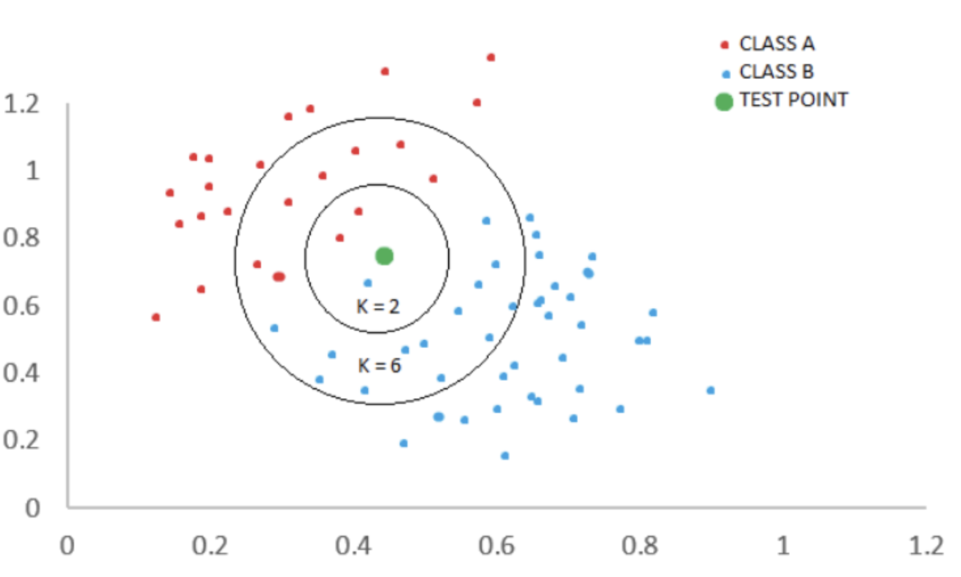
k-Nearest Neighbors (KNN)
Normalized and standardized dataset performed better than unbalanced data (as expected).
Normalized and standardized datasets performed relatively the same.
Disadvantages to KNN
Training & Test Accuracies by Each Data Treatment (K=5):
 | Training Accuracy |  | Test Accuracy
Data Treatment | Unbalanced | Balanced | Unbalanced | Balanced
Unscaled | 0.48 | 0.42 | 0.26 | 0.17
Normalized | 0.69 | 0.65 | 0.55 | 0.47
Standardized | 0.70 | 0.65 | 0.57 | 0.49
Notes:
DAISY
Evolution:
KNN being a popular supervised, classification algorithm, we wanted to test that.
Decided on number of neighbors being 5 because it’s often the default.
Optional: (We also tested 1 and sequential numbers (2, 3, 4, etc.). Training Accuracy was of course 99% for K = 1, and test accuracy remained at around 50% and only gradually got up to 55% as we increased K. Stabilized at 5.)
Key takeaways:
Overall, we found that normalized and standardized data performed better than unbalanced data. This was as expected.
The training accuracy for unscaled and unbalanced is at 48% and unscaled and balanced at 42%. Test accuracies had 26% on unbalanced and 17% on balanced data.
Normalized and Standardized datasets, we have pretty similar accuracy scores with Standardized being slightly better.
We have a training accuracy with around 70% for unbalanced data and 65% for balanced data
Test accuracy with around 55 & 57% and 47 & 49%.
So what?
While KNN is intuitive, simple, and easy to understand. It comes with its disadvantages.
The accuracy score seems ok (I believe typical baseline models have about 60% accuracy), we’ve learned KNN should be performed with caution.
The chosen K will affect the category a test point is assigned into. So choosing the right K is important.
KNN is very sensitive to the data’s scale, irrelevant, or correlated features.
So, we’d recommend further exploration on the results we’re seeing like analyzing the features and its correlation to one another.
Nevertheless, KNN is still suitable for applications with sufficient domain knowledge available.
------------------------------------------------------------------------------------------
Accuracy is simply the percentage of all observations that are correctly classified by the model.
Accuracy = (# True Positives + # True Negatives) / (Total Sample Size)
Accuracy - The amount of correct classifications / the total amount of classifications.
Train accuracy vs test accuracy
The train accuracy - The accuracy of a model on examples it was constructed on.
The test accuracy - is the accuracy of a model on examples it hasn't seen.
Caveat about KNN
Choosing K will affect the category a test point is assigned into.
The quality of the predictions depends on the distance measure. Therefore, the KNN algorithm is suitable for applications where sufficient domain knowledge is available. This knowledge supports the selection of an appropriate measure.
The KNN algorithm is a type of lazy learning, where the computation for the generation of the predictions is deferred until classification. Although this method increases the costs of computation compared to other algorithms, KNN is still the better choice for applications where predictions are not requested frequently but where accuracy is important.

Slide 14
Logistic Regression
We identified correlations between genre and the numeric features.
Energy, duration_ms, and speechiness are the top three correlated features regardless if they are in the unbalanced or the balanced data.
Key takeaways:
Adding features improves accuracy.
Accuracy improves when the data is scaled, with standardized scaling improving accuracy the most.
Accuracy is better on unbalanced data.
Training & Test Accuracies by Each Data Treatment
 | Training Accuracy |  | Test Accuracy
Data Treatment | Unbalanced | Balanced | Unbalanced | Balanced
Unscaled | 0.13 | 0.08 | 0.08 | 0.08
Normalized | 0.55 | 0.48 | 0.57 | 0.40
Standardized | 0.58 | 0.55 | 0.59 | 0.48
Notes:
SHUO / IRIS
We decided to run for 20 epochs in order to see if the model will overfit, and if it does, on which types of data.
When we looked at correlations between genre and the numeric features, we see that energy, duration_ms, and instrumentalness are correlated with genre more than other features. However, we also see there is some multicollinearity with the variables, hinting that this may not be the best model.
We started looking by adding energy and duration_ms.
Then we tried to add speechiness and it improved accuracy.
Since adding more features improved accuracy, we wanted to see if using all the numeric features would continuously improve accuracy, and it did.
Key takeaways:
Adding features improves accuracy.
Scaling data improves the model, with standardized scaling providing the best results.
The validation accuracy seems to be hovering around 0 in the undersampled data, but as it improves towards the end of the 20 epochs, it suggests that additional epochs will be needed to improve accuracy.
You can pick the best version of your model and describe what work and didn’t with different adjustments to the dataset. Why do you think you got the results you did?

Slide 15
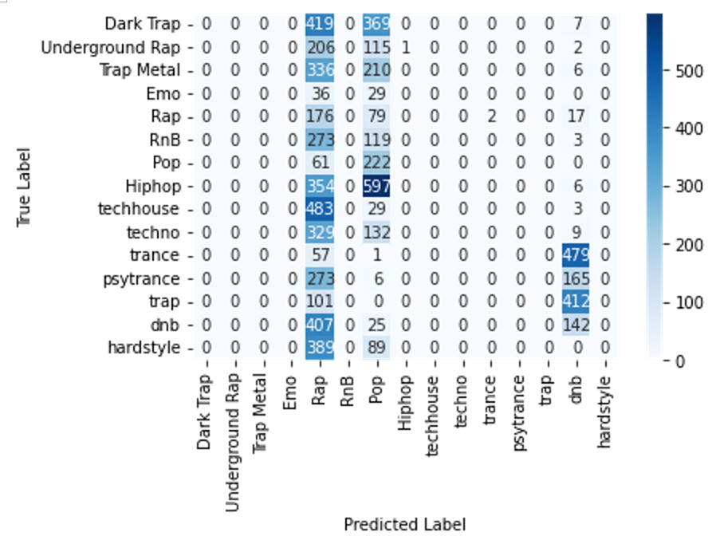
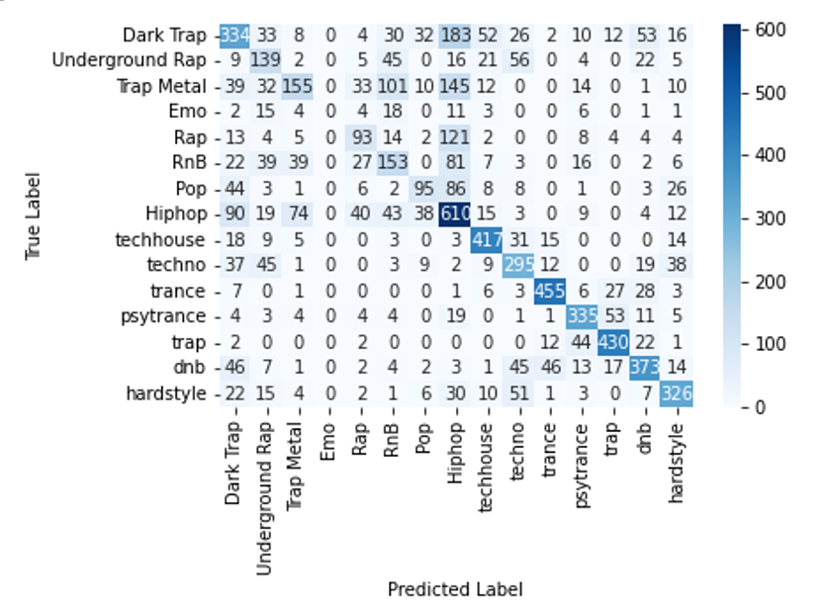
Logistic Regression
Unscaled data generally predicts fewer genres.
Once the features are scaled, predictions are more varied (example below uses standardized data).
Both figures are from the models trained on the unbalanced dataset.
Notes:
SHUO / IRIS
We looked at confusion matrices to identify why we were getting low accuracies with the unscaled data.
Using unscaled data typically lends the model to predict fewer genres.
Once the features are scaled, predictions are more varied.

Slide 16
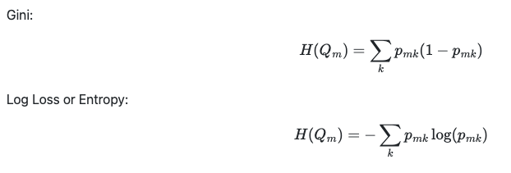
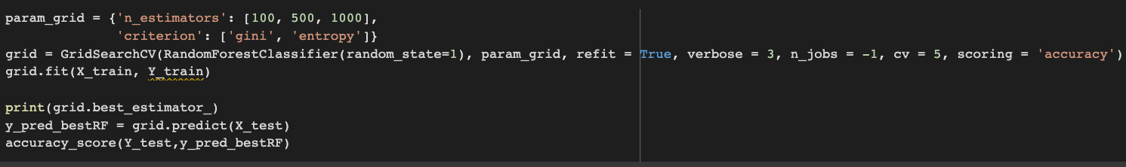
Random Forest
Balanced dataset performed a little bit worse than unbalanced dataset (not expected).
Normalized, standardized, and unscaled datasets performed relatively the same.
Combination (3x2x5 = 30):
The number of trees in the forest.
'n_estimators': [100, 500, 1000]
The function to measure the quality of a split
'criterion': ['gini', 'entropy']
Test Accuracies by Each Data Treatment
 | Test Accuracy
Data Treatment | Unbalanced | Balanced
Unscaled | 0.70 | 0.64
Normalized | 0.71 | 0.62
Standardized | 0.70 | 0.61
Notes:
SHUO / IRIS
Evolution:
We used a combination of the number of trees in the forest, the number of estimators, and different criterion function to measure the quality of a split.
'n_estimators': [100, 500, 1000]
'criterion': ['gini', 'entropy']
Key Takeaways:
We discovered that the balanced dataset performed a little bit worse than the unbalanced dataset (which was not expected), but it did not matter how the data was scaled.
The best models used 500 n_estimators with the gini criterion

Slide 17
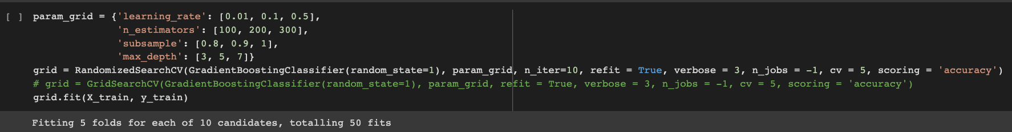
Gradient Boosting
Balanced dataset performed a little bit worse than unbalanced data (not expected).
Normalized, standardized, and unscaled datasets performed relatively the same.
Combination (3x3x3x3x5 = 405):
'learning_rate': [0.01, 0.1, 0.5]
The number of boosting stages to perform.
'n_estimators': [100, 200, 300]
The fraction of samples to be used
for fitting the individual base learners
'subsample': [0.8, 0.9, 1]
The maximum depth of the individual regression estimators.
The maximum depth limits the number of nodes in the tree
'max_depth': [3, 5, 7]}
Test Accuracies by Each Data Treatment
 | Test Accuracy
Data Treatment | Unbalanced | Balanced
Unscaled | 0.70 | 0.63
Normalized | 0.70 | 0.57
Standardized | 0.70 | 0.60
Notes:
IVAN / SHUO
Evolution:
We used a combination of the learning_rate, the number of boosting stages, the fraction of samples, and the maximum depth of individual regression estimators (or the number of nodes) to measure the quality of a split.
‘Learning_rate’: [0.01, 0.1, 0.5]
'n_estimators': [100, 500, 1000]
‘subsample’: [0.8, 0.9, 1]
‘Max_depth’: [3, 5, 7]
Key Takeaways:
We discovered that the balanced dataset performed a little bit worse than the unbalanced dataset (which was not expected), but it did not matter how the data was scaled.
There are 405 combinations, we randomly chose 10 cases to run and get the best result. (as shown in the PPT)

Slide 18
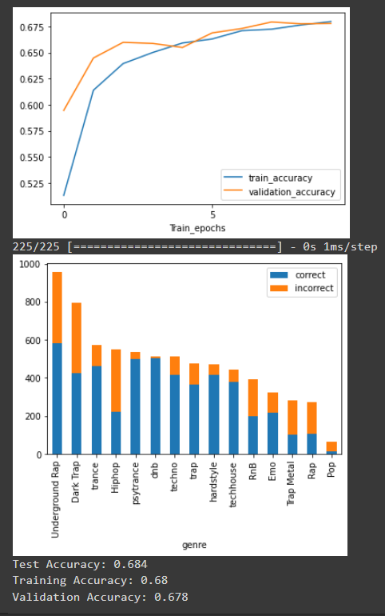
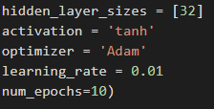
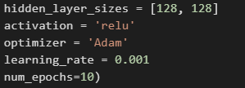
Neural Network
Test Accuracies by Each Data Treatment with fixed hyperparameters
 | Test Accuracy
Data Treatment | Unbalanced | Balanced
Unscaled | 0.133 | 0.055
Normalized | 0.615 | 0.424
Standardized | 0.664 | 0.54
Test Accuracy with different hyperparameters
 | Test Accuracy
Data Treatment | Unbalanced
Standardized | 0.684
Notes:
IVAN / AMANDA
Best: Unscaled, standardized, hyperparams
Variations
normalized/standardized/unscaled

Slide 19
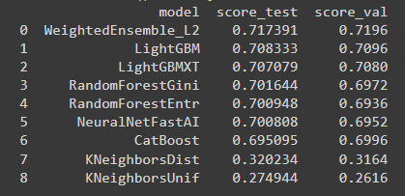
What have we learned?
Feature scaling and balancing data is crucial for some models
The benefits of different feature engineering techniques will vary from model to model
Establishing a baseline gave us better appreciation for our model, even though the accuracy wasn’t objectively high
More investigation into balancing techniques could be helpful
For “fun”, we used AutoGluon to see how an AutoML package would perform on our data… we can see our results were almost as good
Notes:
AMANDA

Slide 20
Thank you!

Slide 21
Extra Slides

Slide 22
Analysis
Why did we get the results we did?
Can we explain our results and context that might’ve contributed to our results?
Are the results what we expected? Why or why not?

